Slide 1
MGMT 410
Corporate Governance and Social Responsibility
Session 4 – Business in a Globalized World
Ozan Duygulu

Slide 2
Learning Objectives
Defining globalization and classifying the major ways in which companies enter the global marketplace.
Identifying the international financial and trade institutions that have shaped the globalization process in recent decades.
Analyzing the benefits and costs of the globalization of business.
Identifying the major types of political and economic systems in which companies operate across the world.
Understanding global inequalities of wealth and income and analyzing the special challenges of serving those at the “bottom of the pyramid.”
Assessing how businesses can work collaboratively with governments and the civil sector to address global social issues.

Slide 3
The Process of Globalization
Globalization refers to the increasing movement of goods, services, capital, and labor across national borders
Friedman (2000): “Globalization is not simply a trend or a fad but is, rather, an international system. It is the system that has now replaced the old Cold War system, and, like that Cold War system, globalization has its own rules and logic that today directly or indirectly influence the politics, environment, geopolitics, and economics of virtually every country in the world.

Slide 4
The Process of Globalization
A multinational enterprise (MNE) is a firm with significant foreign assets or revenues, or that has subsidiaries outside its home country
Foreign direct investment (FDI) occurs when a company, individual, or fund invests money in another country, for example, by buying shares of stock in or loaning money to a foreign firm

Slide 5
International Financial and Trade Institutions
Global commerce is carried out in the context of a set of important international financial and trade institutions (IFTIs)
Major IFTIs
The World Bank (WB) was set up in 1944, near the end of World War II, to provide economic development loans to its member nations
International Monetary Fund (IMF): Sister organization of WB. Stabilize the system of currency exchange rates and international payments to enable member countries to participate in global trade
World Trade Organization (WTO), founded in 1995 as a successor to the General Agreement on Tariffs and Trade (GATT), is an international body that establishes the ground rules for trade among nations

Slide 6
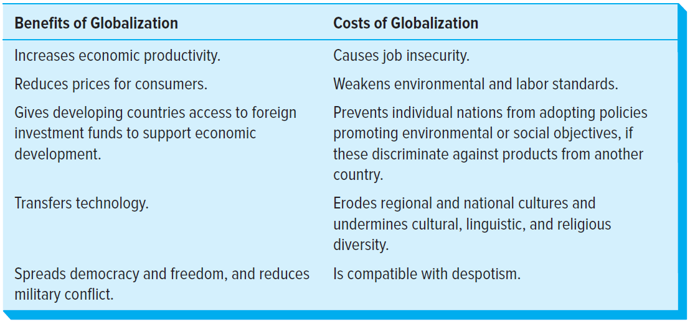
Benefits and Costs of Globalization

Slide 7
Political and Economic Systems
As a social order, we must figure out three things:
What will we produce?
How to produce it?
Who will get it?

Slide 8
Two Major Economic Systems
Market Economy vs. Planned Economy
In planned economy, government controls labor, land and capital.
Communism is primarily defined by the lack of private property. Class-lessness is a symptom of having no private property. There are no communist countries in the world.
Often socialism has some private property and some public ownership.
Command economy is totally controlled by government.
In market economies, individuals control production to get profit.
Invisible hand - the unintended social benefits resulting from individual actions

Slide 9

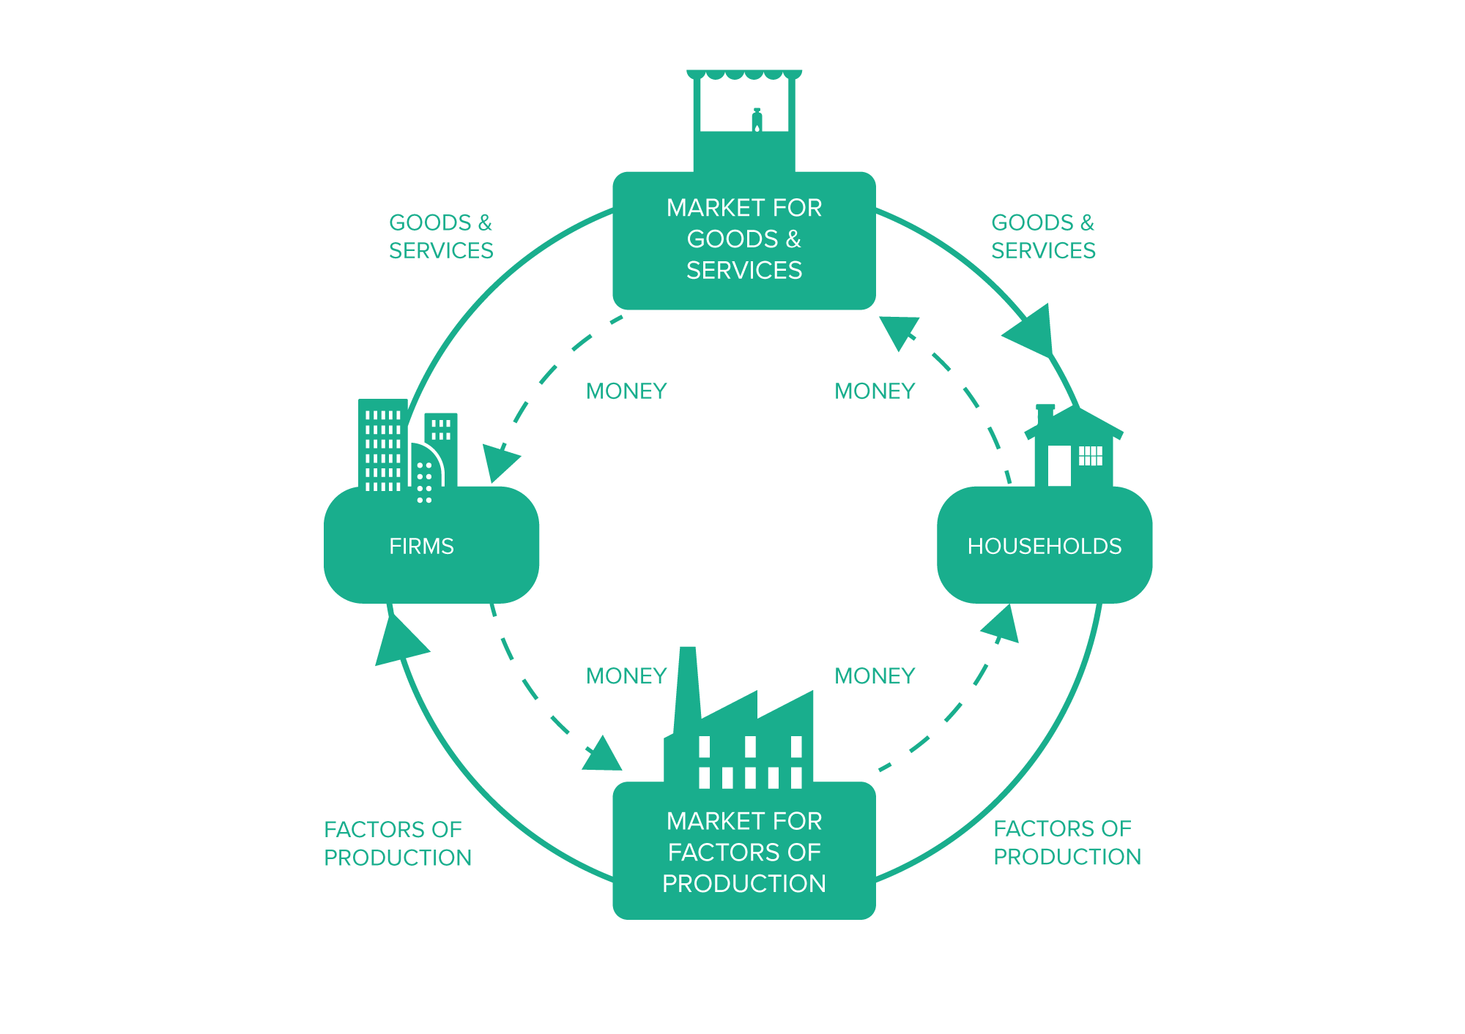
Modern Economies
Neither completely free market nor planned.
Level of government involvement changes everywhere

Slide 10
Modern Economies
Neither completely free market nor planned.
Level of government involvement changes everywhere
What is wrong with this circular economy?

Slide 11
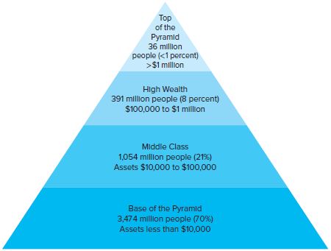
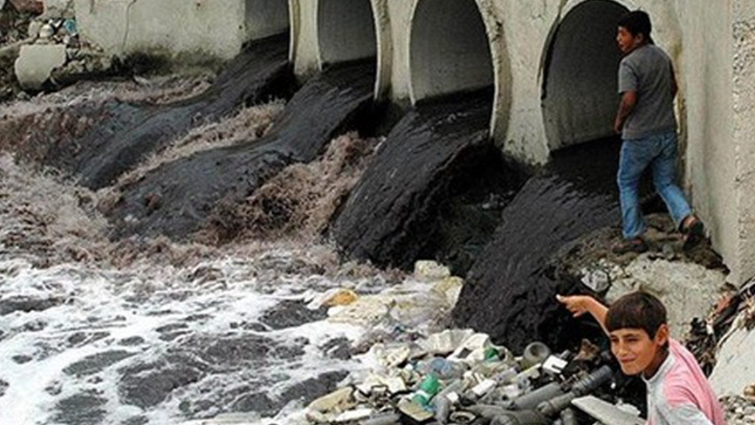
Challenges to Modern Economic Systems

Slide 12
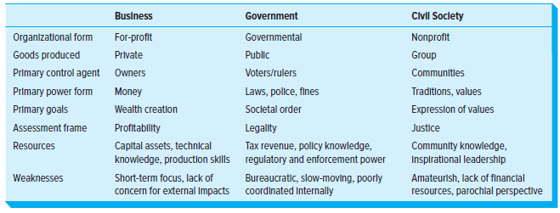
Three Sectors in Modern Economies

Slide 13
Capitalism
https://www.youtube.com/watch?v=dIuaW9YWqEU&t=386s

Slide 14
Capitalism
Benefit | Problem
Economic growth: Capitalism has been shown to be the most effective economic system for generating economic growth. | Inequality: Capitalism can lead to high levels of inequality, as those who own capital tend to accumulate more and more wealth over time.
Innovation: Capitalism incentivizes businesses to innovate and develop new products and services in order to compete for market share. | Environmental damage: Capitalism can lead to environmental damage, as businesses often prioritize profits over environmental protection.
Consumer choice: Capitalism provides consumers with a wide range of choices when purchasing goods and services. | Short-termism: Capitalism can lead to short-termism, as businesses focus on maximizing profits in the short term, even if it means sacrificing long-term sustainability.
Economic freedom: Capitalism gives individuals the freedom to start their own businesses and pursue their own economic goals. | Market failures: Capitalism can be susceptible to market failures, such as monopolies and externalities.

Slide 15
Varieties of Capitalism
Variety of capitalism | Key characteristics | Examples
Liberal market economy (LME) | High level of market competition, low level of government intervention, flexible labor markets, and a relatively weak social safety net. | United States, United Kingdom, Canada, Australia, and New Zealand
Coordinated market economy (CME) | High level of coordination between businesses, government, and labor unions, long-term investment horizons, and a strong social safety net. | Germany, Japan, Sweden, and Austria
Social democratic capitalism | Combines elements of LMEs and CMEs, with a focus on social welfare and economic equality. | Denmark, Norway, Finland, and the Netherlands
Asian capitalism | A unique form of capitalism that is characterized by strong government intervention, close ties between businesses and government, and a focus on export-oriented growth. | South Korea, Taiwan, and Singapore
Mediterranean capitalism | A form of capitalism that is characterized by a large informal sector, family-owned businesses, and weak institutions. | Greece, Italy, and Spain

